Slide 1
New York-taxi-data analysis
Group 13
Vineeth Avula
Srikar Gaddipati
Likhitha Alla
Nikhita Somanchi
Kamala Kumari Karuturi

Slide 2
BUSINESS OBJECTIVE:
The main objective of this project is to forecast the demand during surge for a taxi company.
Though the mobile application is doing well by handling huge amount of load, the company wants to increase its productivity by forecasting the surge and increasing prices.

Slide 3
DATA SELECTION:
We have selected data of New York City Taxi and Limousine Commission (TLC) Trip Record.
The New York City Taxi and Limousine Commission (TLC), created in 1971, is the agency responsible for licensing and regulating New York City's Medallion (Yellow) taxi cabs, for-hire vehicles (community-based liveries, black cars, and luxury limousines), commuter vans, and paratransit vehicles.

Slide 4
PREDICTION ANALYSIS
Our goal is to examine the dataset and analyze the results to identify the best approach that the organization can use to meet its demand forecasting objectives.
Pick-up hourly distribution
Pick-up weekday distribution
Vendor pick-up hour density, by weekday

Slide 5
RESEARCH OBJECTIVES AND QUESTIONS
Our objective is to find hourly and weekly taxi demand surge patterns
To implement the solution, we plan to employ AWS technologies as part of our research. The key here is to implement appropriate models and algorithms to predict a pattern in the surge in demand.

Slide 6
DATA UNDERSTANDING
PULocationID – It consists of the pickup locations of the customers.
DOLocationID – It consists of the drop-off locations.
Passenger Count- It consists of Passenger count in a ride.
Trip distance – It consists of the total distance of a trip.

Slide 7
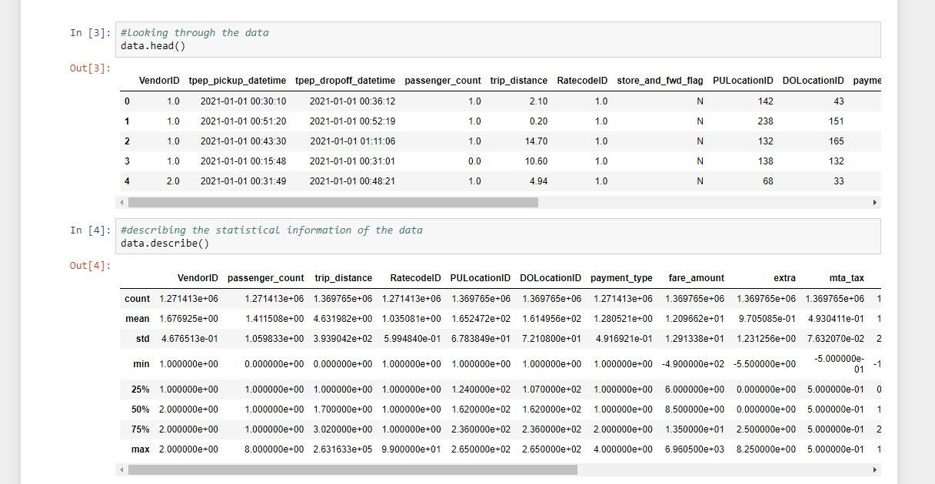
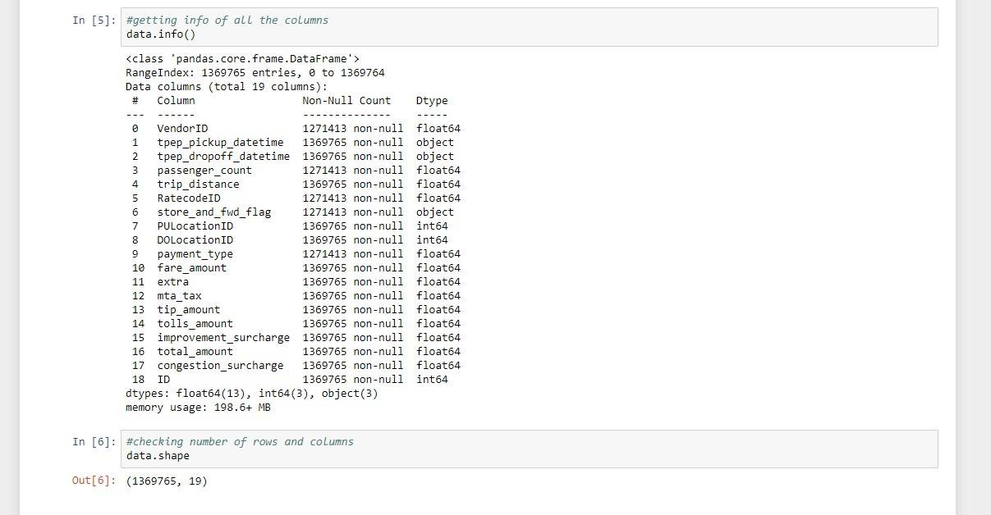

Slide 8
EXPLARATORY DATA ANALYSIS:
From the datasets, we can analyse that there are 258 unique pickup locations and 260 drop locations.
On understanding, we can explain that Friday has the highest number of rides, Next comes Thursday and Wednesday, and the least number of rides are on Sunday.
Amongst the rides, the most number of passenger count for rides is 1 and followed by 2.

Slide 9
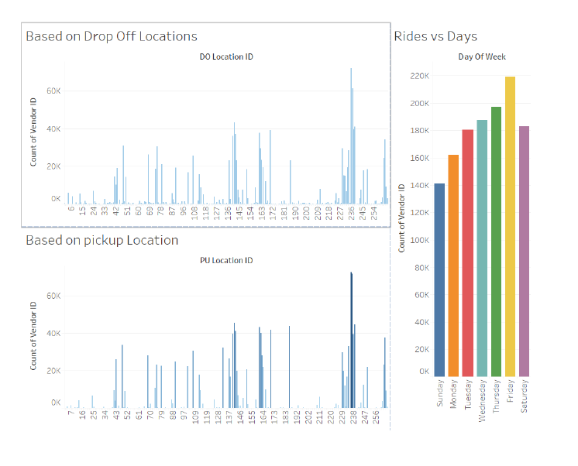

Slide 10
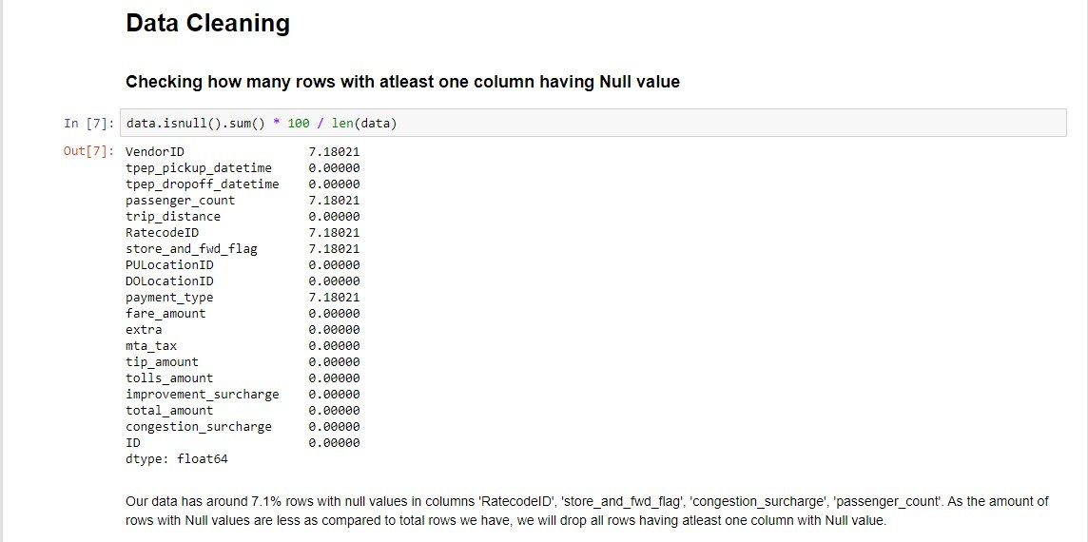
DATA PREPARATION
In this stage, we prepare our data for analysis. Here, we employ several data-cleaning techniques.

Slide 11
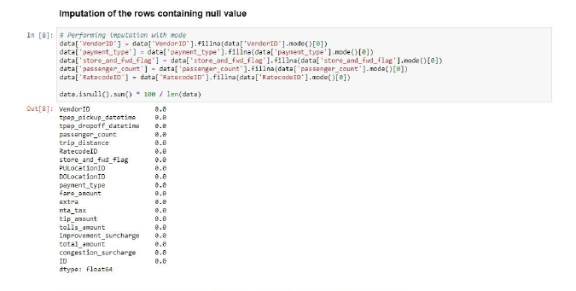

Slide 12
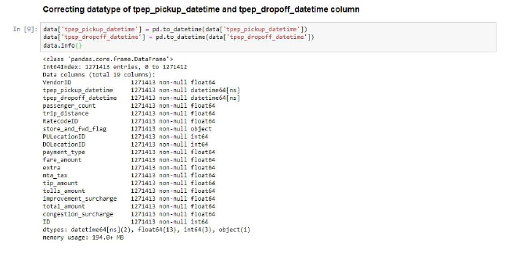

Slide 13
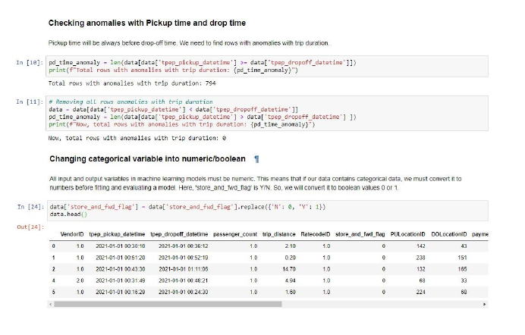

Slide 14
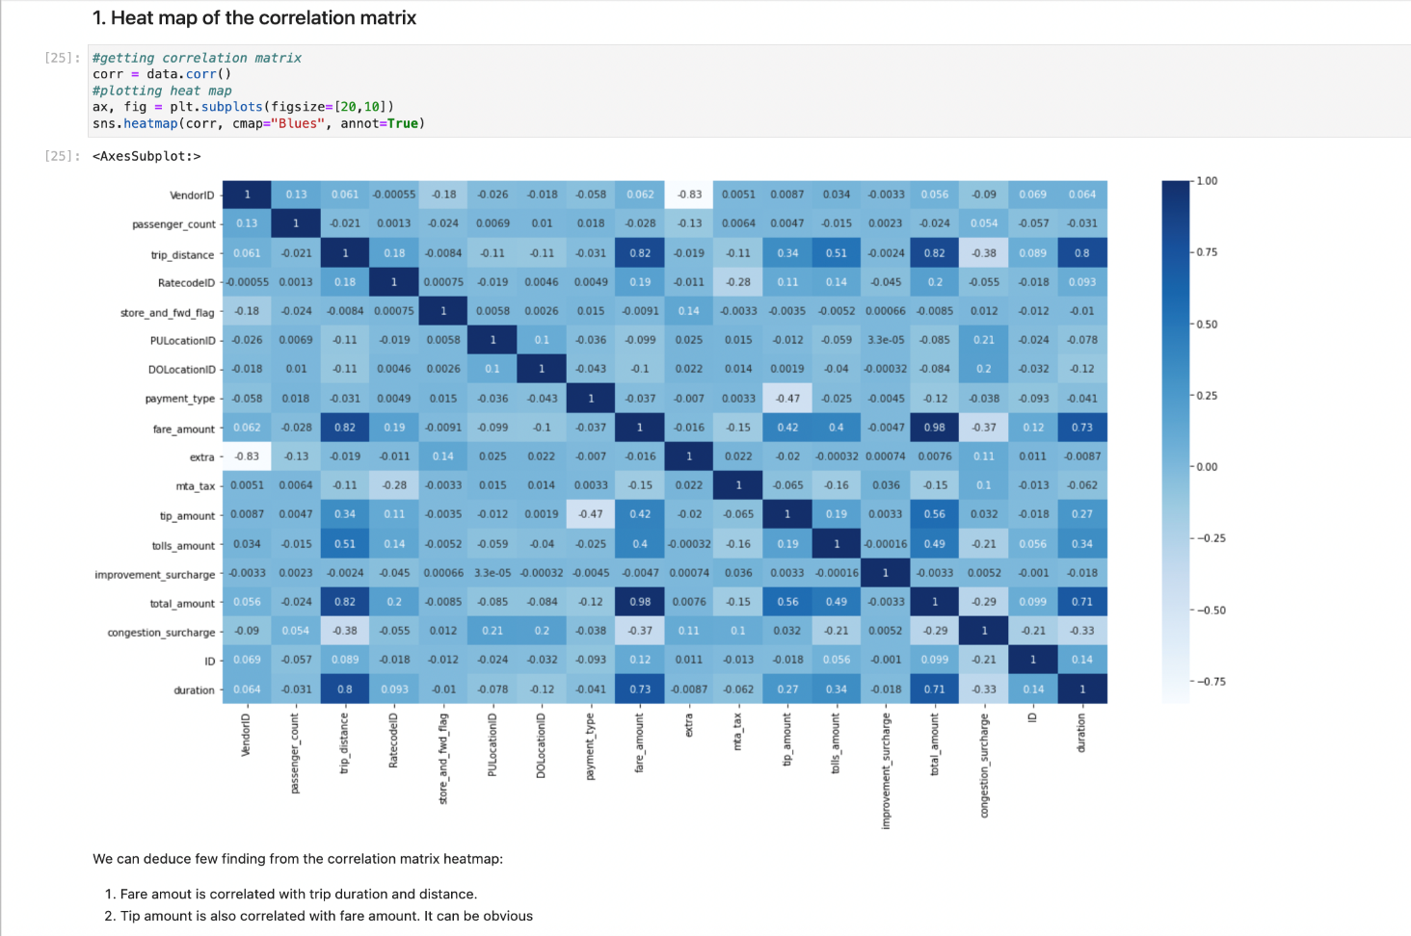
ANALYTICS, MACHINE LEARNING
HEAT MAP OF CORRELATION MATRIX

Slide 15
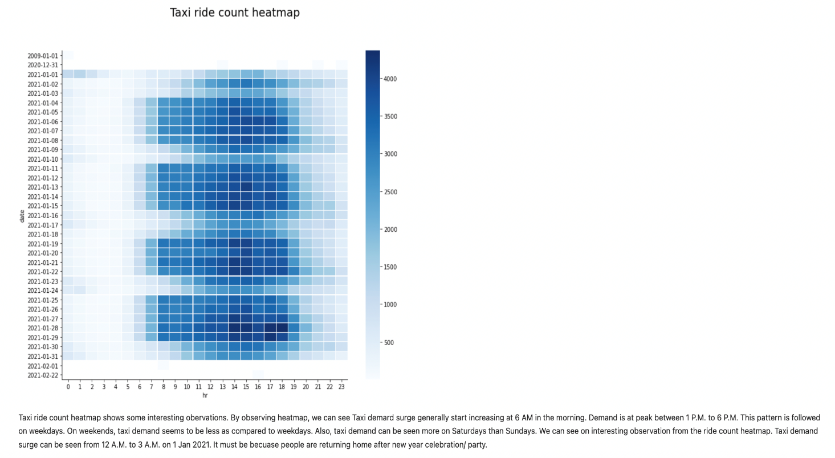
TAXI RIDE HEAT MAP:

Slide 16
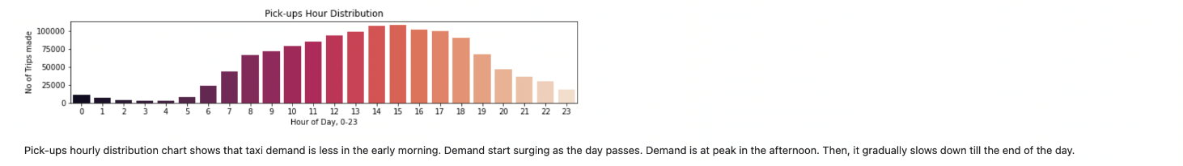
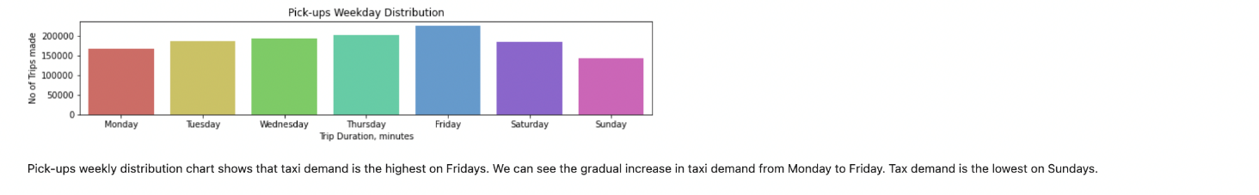
PICK-UPS HOURLY DISTRIBUTION
PICK-UPS MONTHLY DISTRIBUTION:

Slide 17
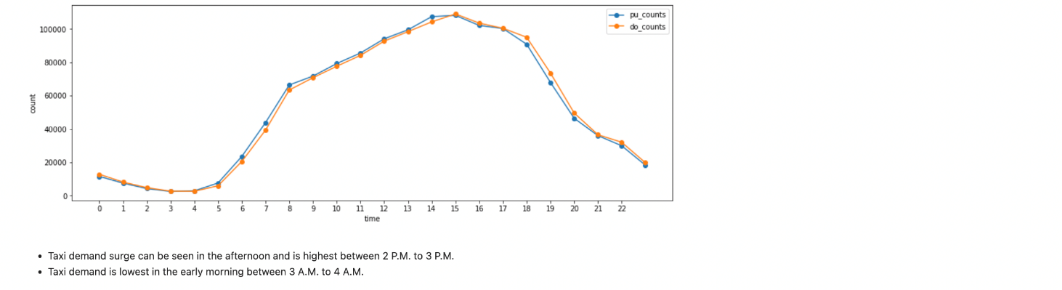
EVALUATION & OPTIMIZATION:

Slide 18
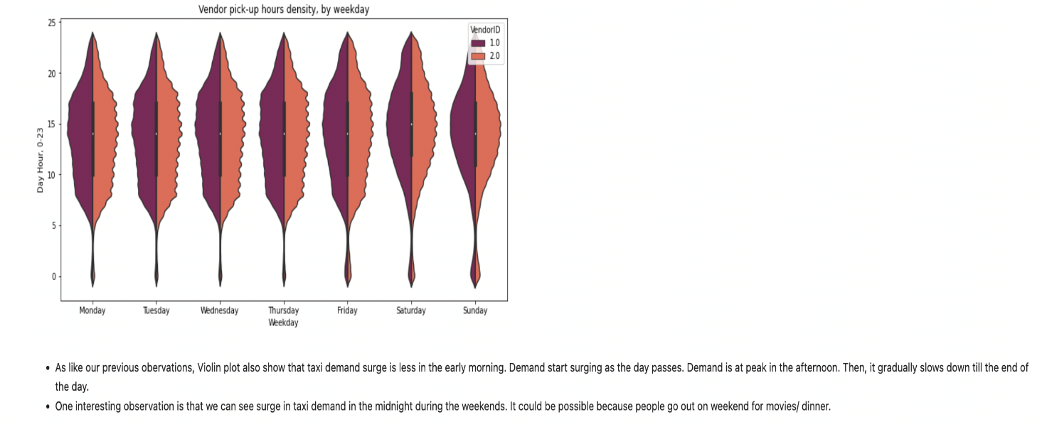
VENDOR PICK-UP HOURS DENSITY, BY WEEKDAY:

Slide 19
RESULTS
From the data that we have analyzed the following are the observations we are able to predict:
It’s clear that tip amount is correlated with fare amount.
It is also observed that trip amount is linked with the distance to be traveled and duration of the trip.
With the help of a heat map it’s predictable that demand for taxis set to increase from 06:00 AM in the morning and its at peak during 01:00 PM to 06:00 PM which is during weekdays.
During weekends demand for taxis seems to be more compared to weekdays.
From the bar graph that’s plotted for Pick-ups hourly distribution depicted that demand for taxi is set to be in increasing trend from 05:00 AM to 3:00 PM and then decreased gradually.
Pick-ups hourly distribution is the highest 02:00 PM to 03:00 PM but almost the same in between 04:00 PM to 05:00 PM.
Pick-ups hourly distribution is lowest during early morning i.e., in between 02:00 AM to 04:00 AM.
Pick-ups Week-day distribution is high on Friday which is approximately 2.5 Lakh trips made. It can also be seen that demand is lowest on Sunday and it gradually increases from Monday.
In the case of Vendor pickup hours density i.e., Violin plot it can be understood that the surge for taxi demand is less during early hours and more during midnights mainly on weekends.

